Slide 1

THE LINEAR MODELS
Risman Adnan Mattotorang
rismanadnan@telkomuniversity.ac.id

Slide 2




OUTLINE
LINEAR MODEL FOR REGRESSION
LINEAR MODEL FOR CLASSIFICATION
LINEAR MODELS IN SCIKIT-LEARN
WEEK 2 HOMEWORK

Slide 3


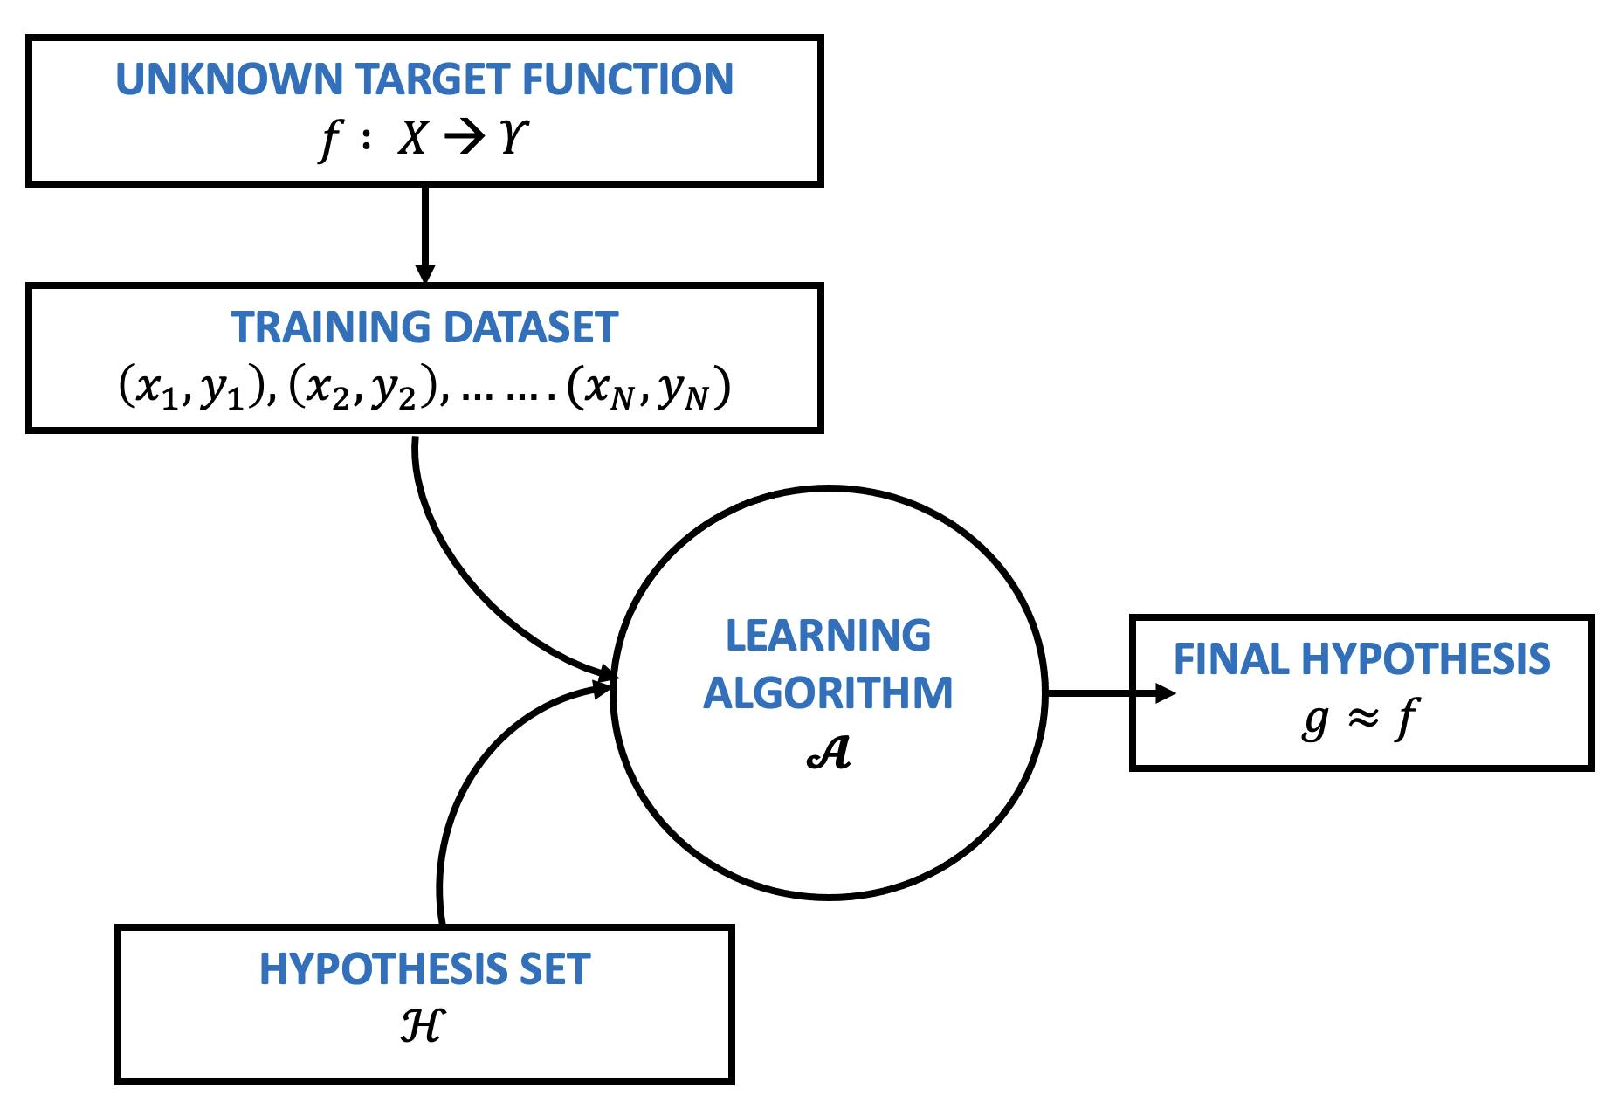


SUPERVISED LEARNING
The data that we can learn from.
A model of how to transform the data.
MODEL
An objective function that quantifies how well (or badly) the model is doing.
An algorithm to adjust the model’s parameters to optimize the objective function.

Slide 4

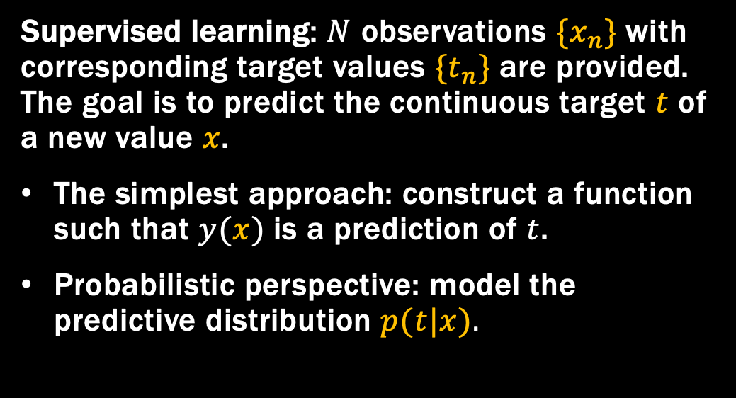
LINEAR MODEL FOR REGRESSION

Slide 5
LINEAR MODEL FOR REGRESSION
Linear Basis Function Models
The Bias-Variance Decomposition
Bayesian Linear Regression
Bayesian Model Comparison
The Evidence Approximation
Limitations of Fixed Basis Functions

Slide 6
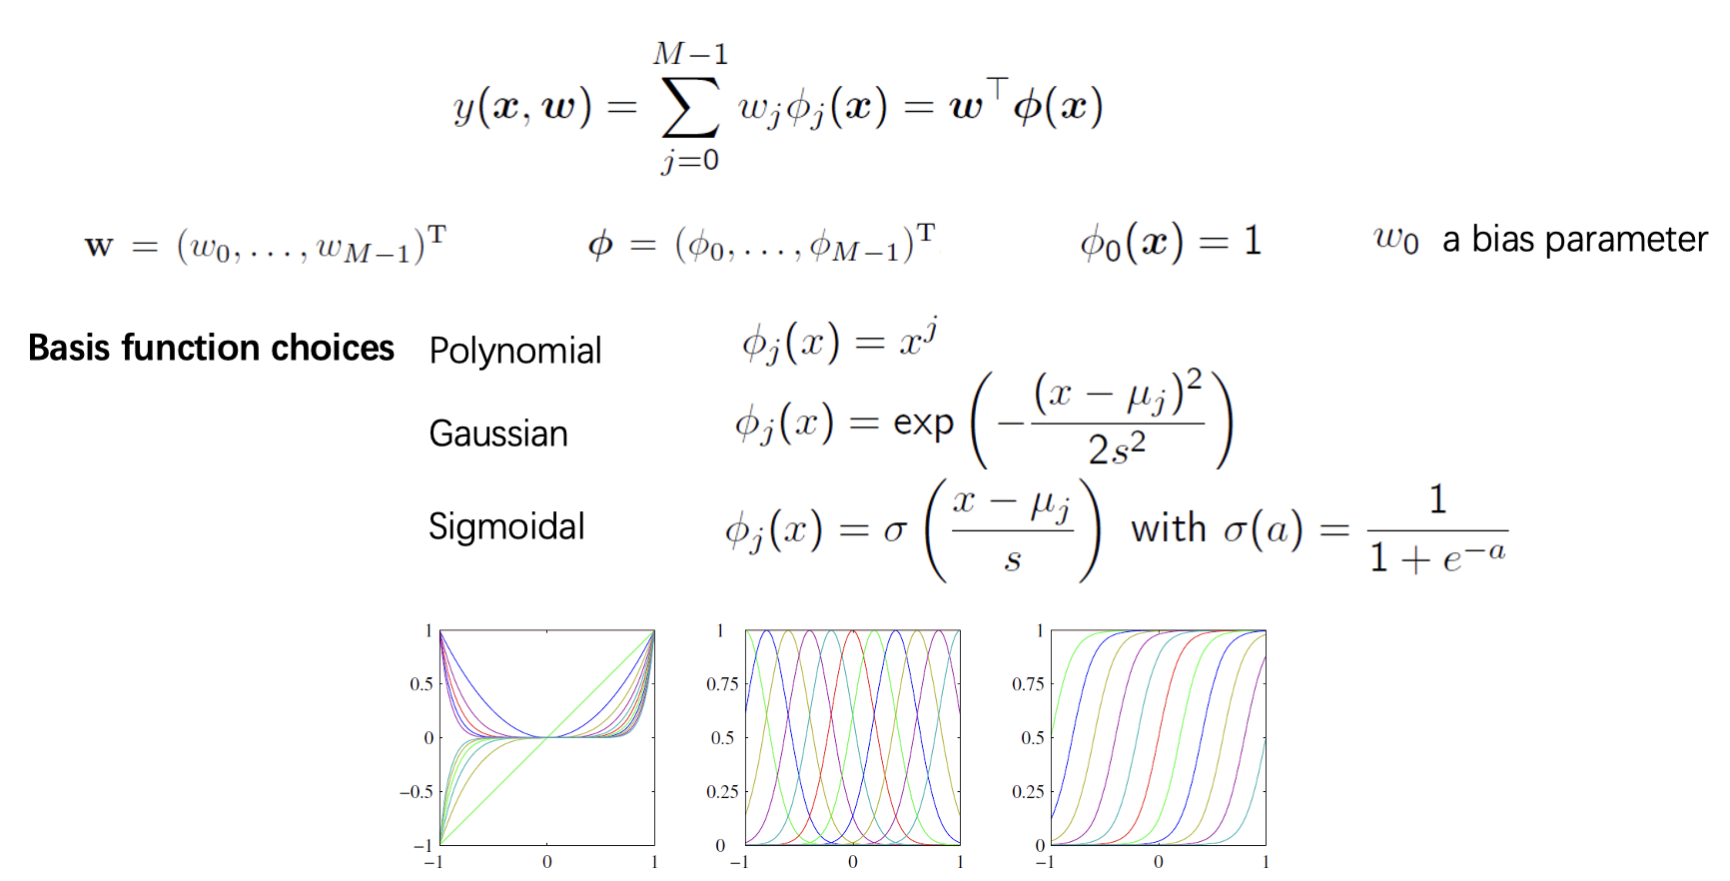
LINEAR BASIS FUNCTIONS

Slide 7
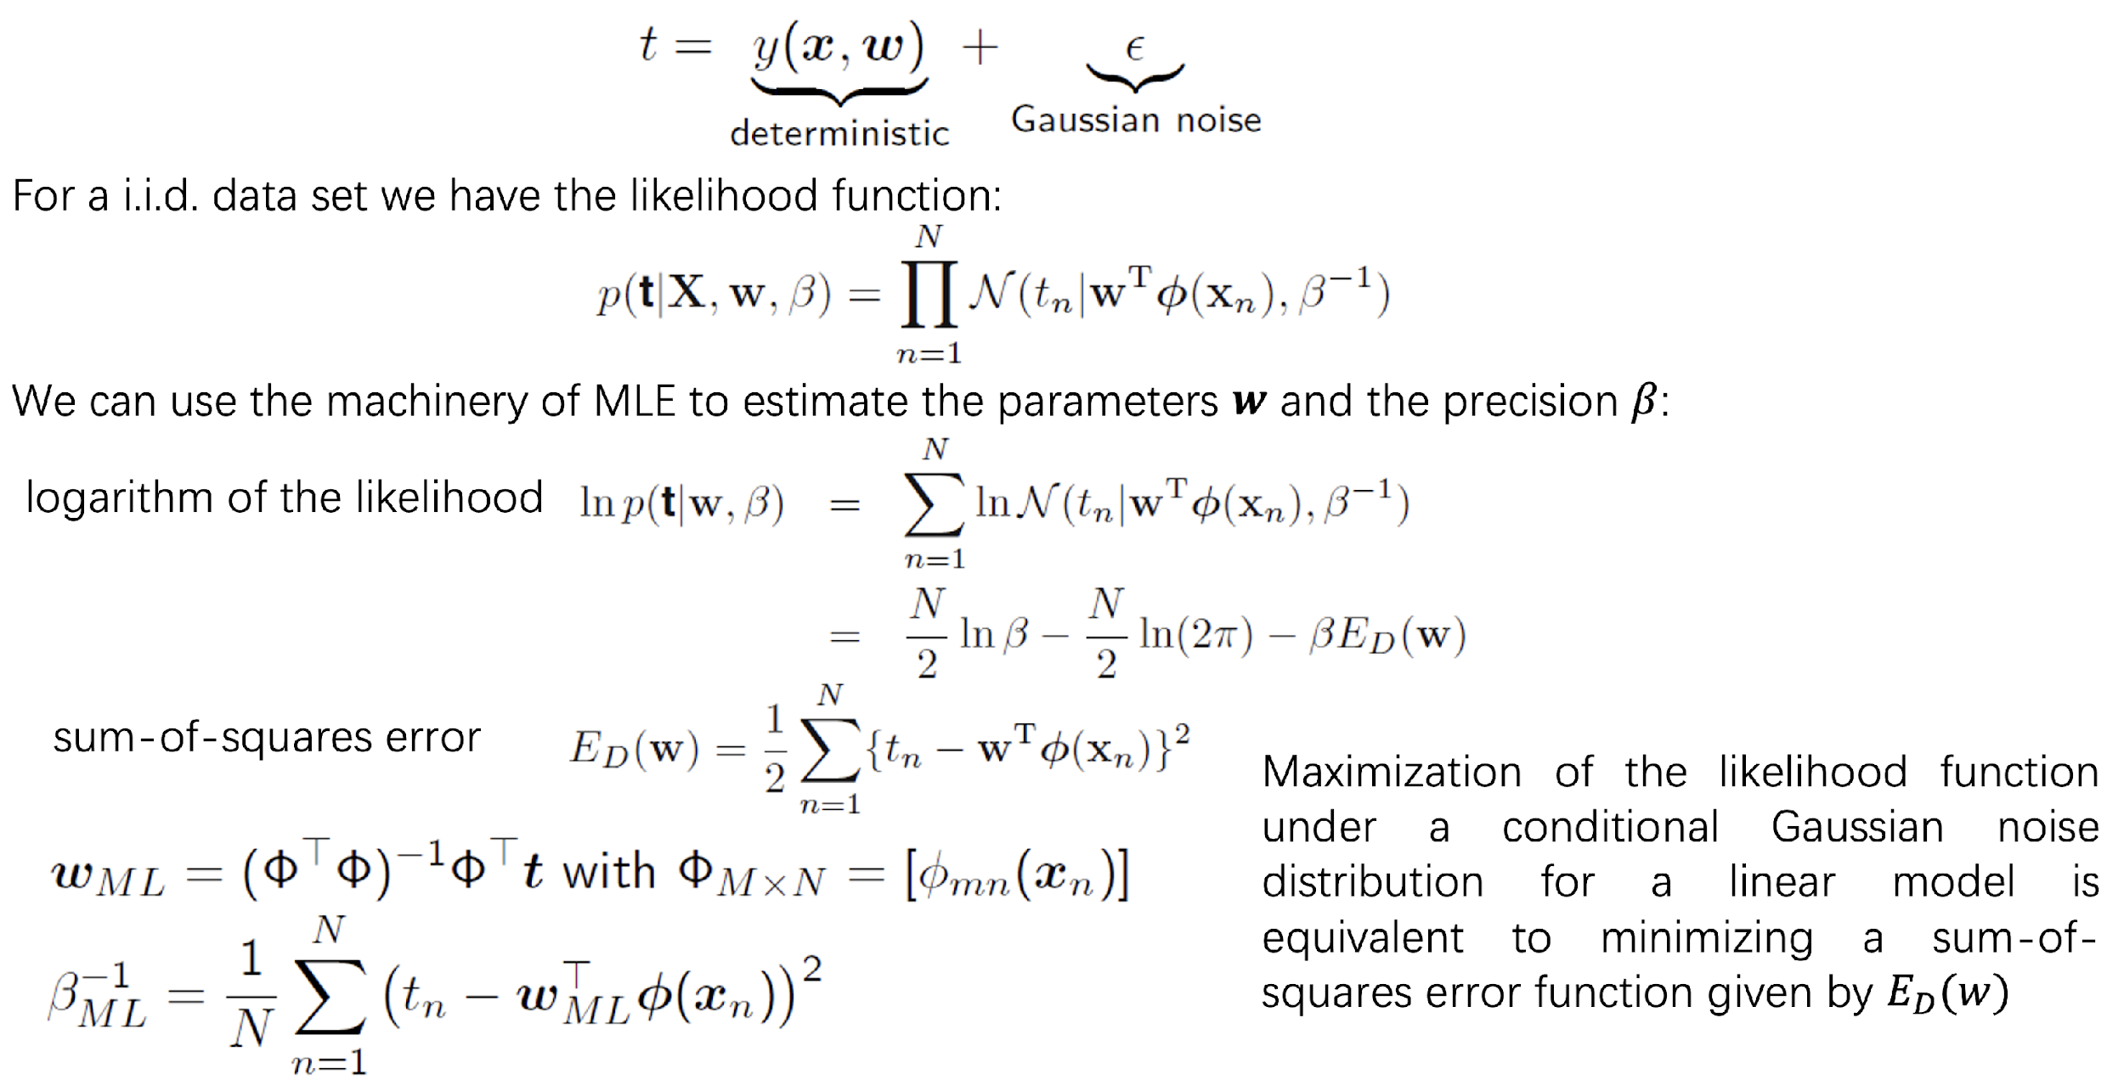
MLE LEAST SQUARE
Maximum Likelihood and Least Squares

Slide 8
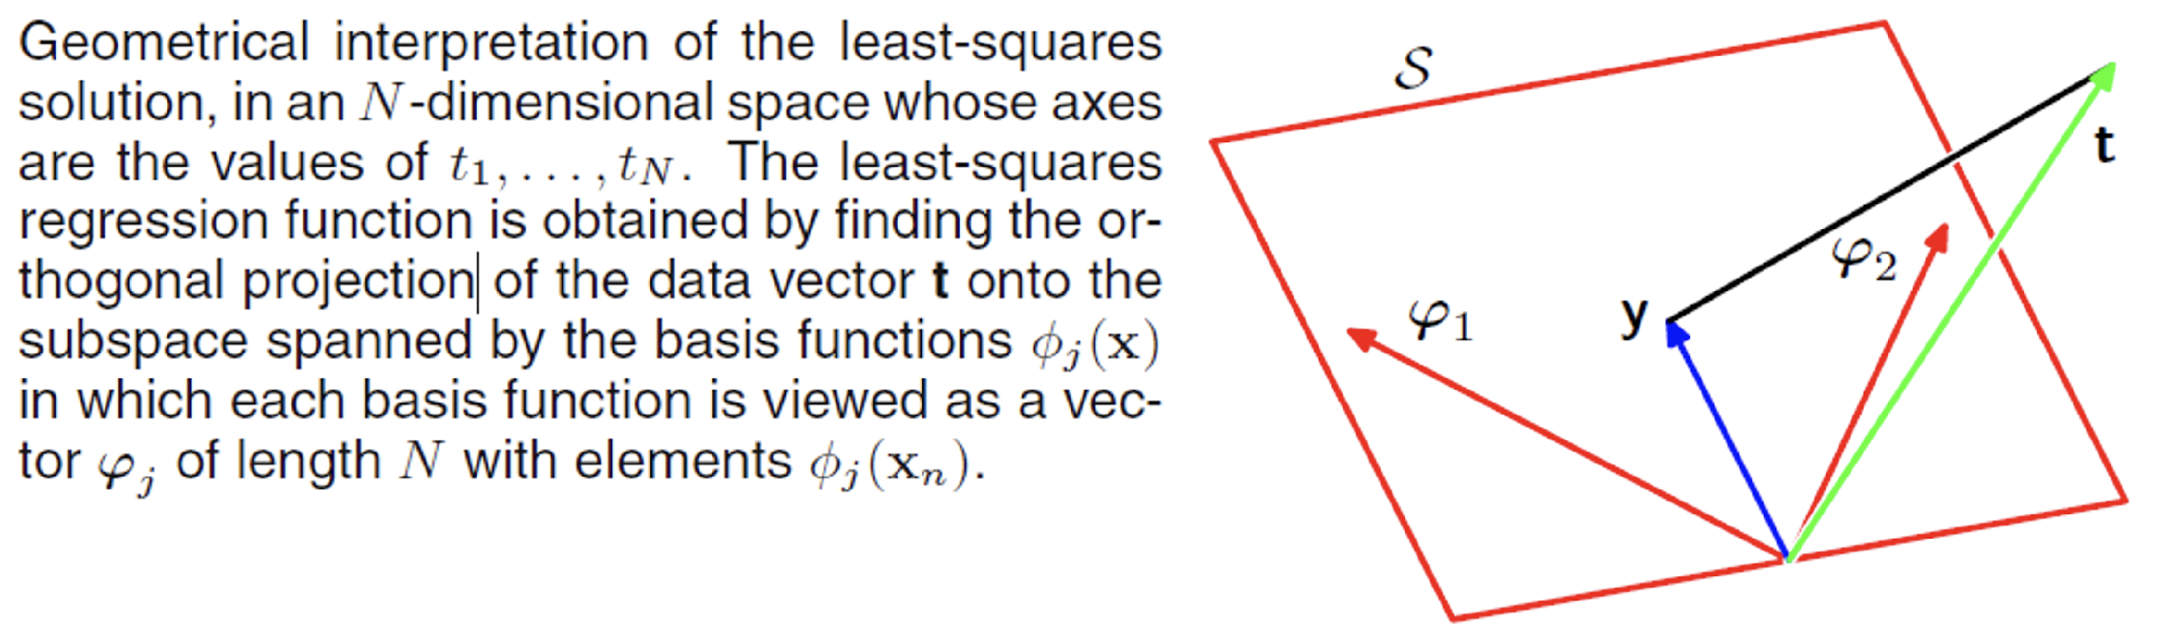
GEOMETRIC INTERPRETATION

Slide 9
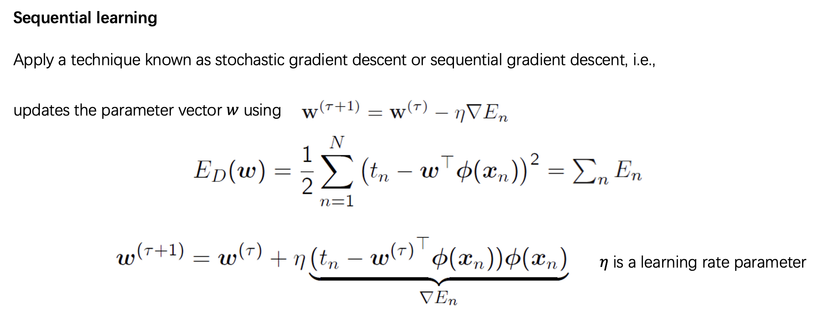
SEQUENTIAL LEARNING

Slide 10
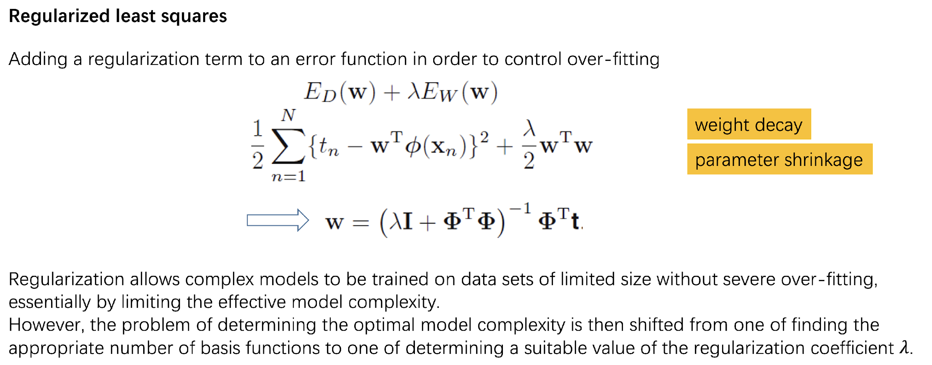
REGULARIZED LEAST SQUARES

Slide 11
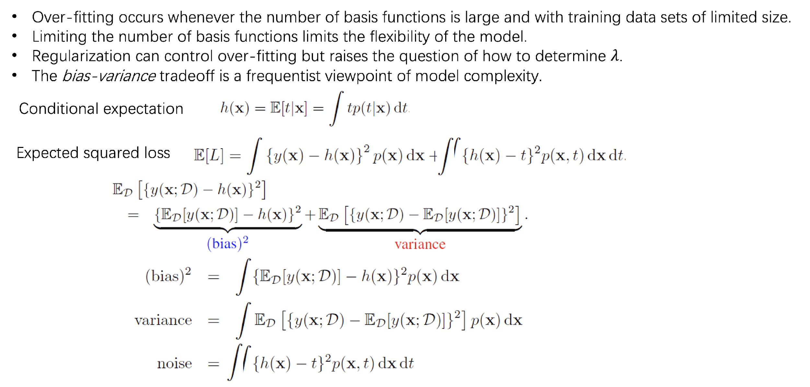
BIAS VARIANCE DECOMPOSITION
StatQuest Here

Slide 12
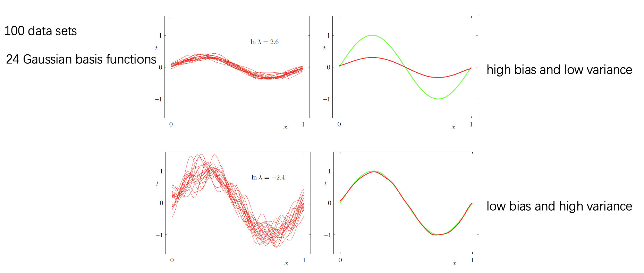
BIAS VARIANCE DECOMPOSITION

Slide 13
OUTLINE
LINEAR MODEL FOR REGRESSION
LINEAR MODEL FOR CLASSIFICATION
LINEAR MODELS IN SCIKIT-LEARN
WEEK 2 HOMEWORK

Slide 14
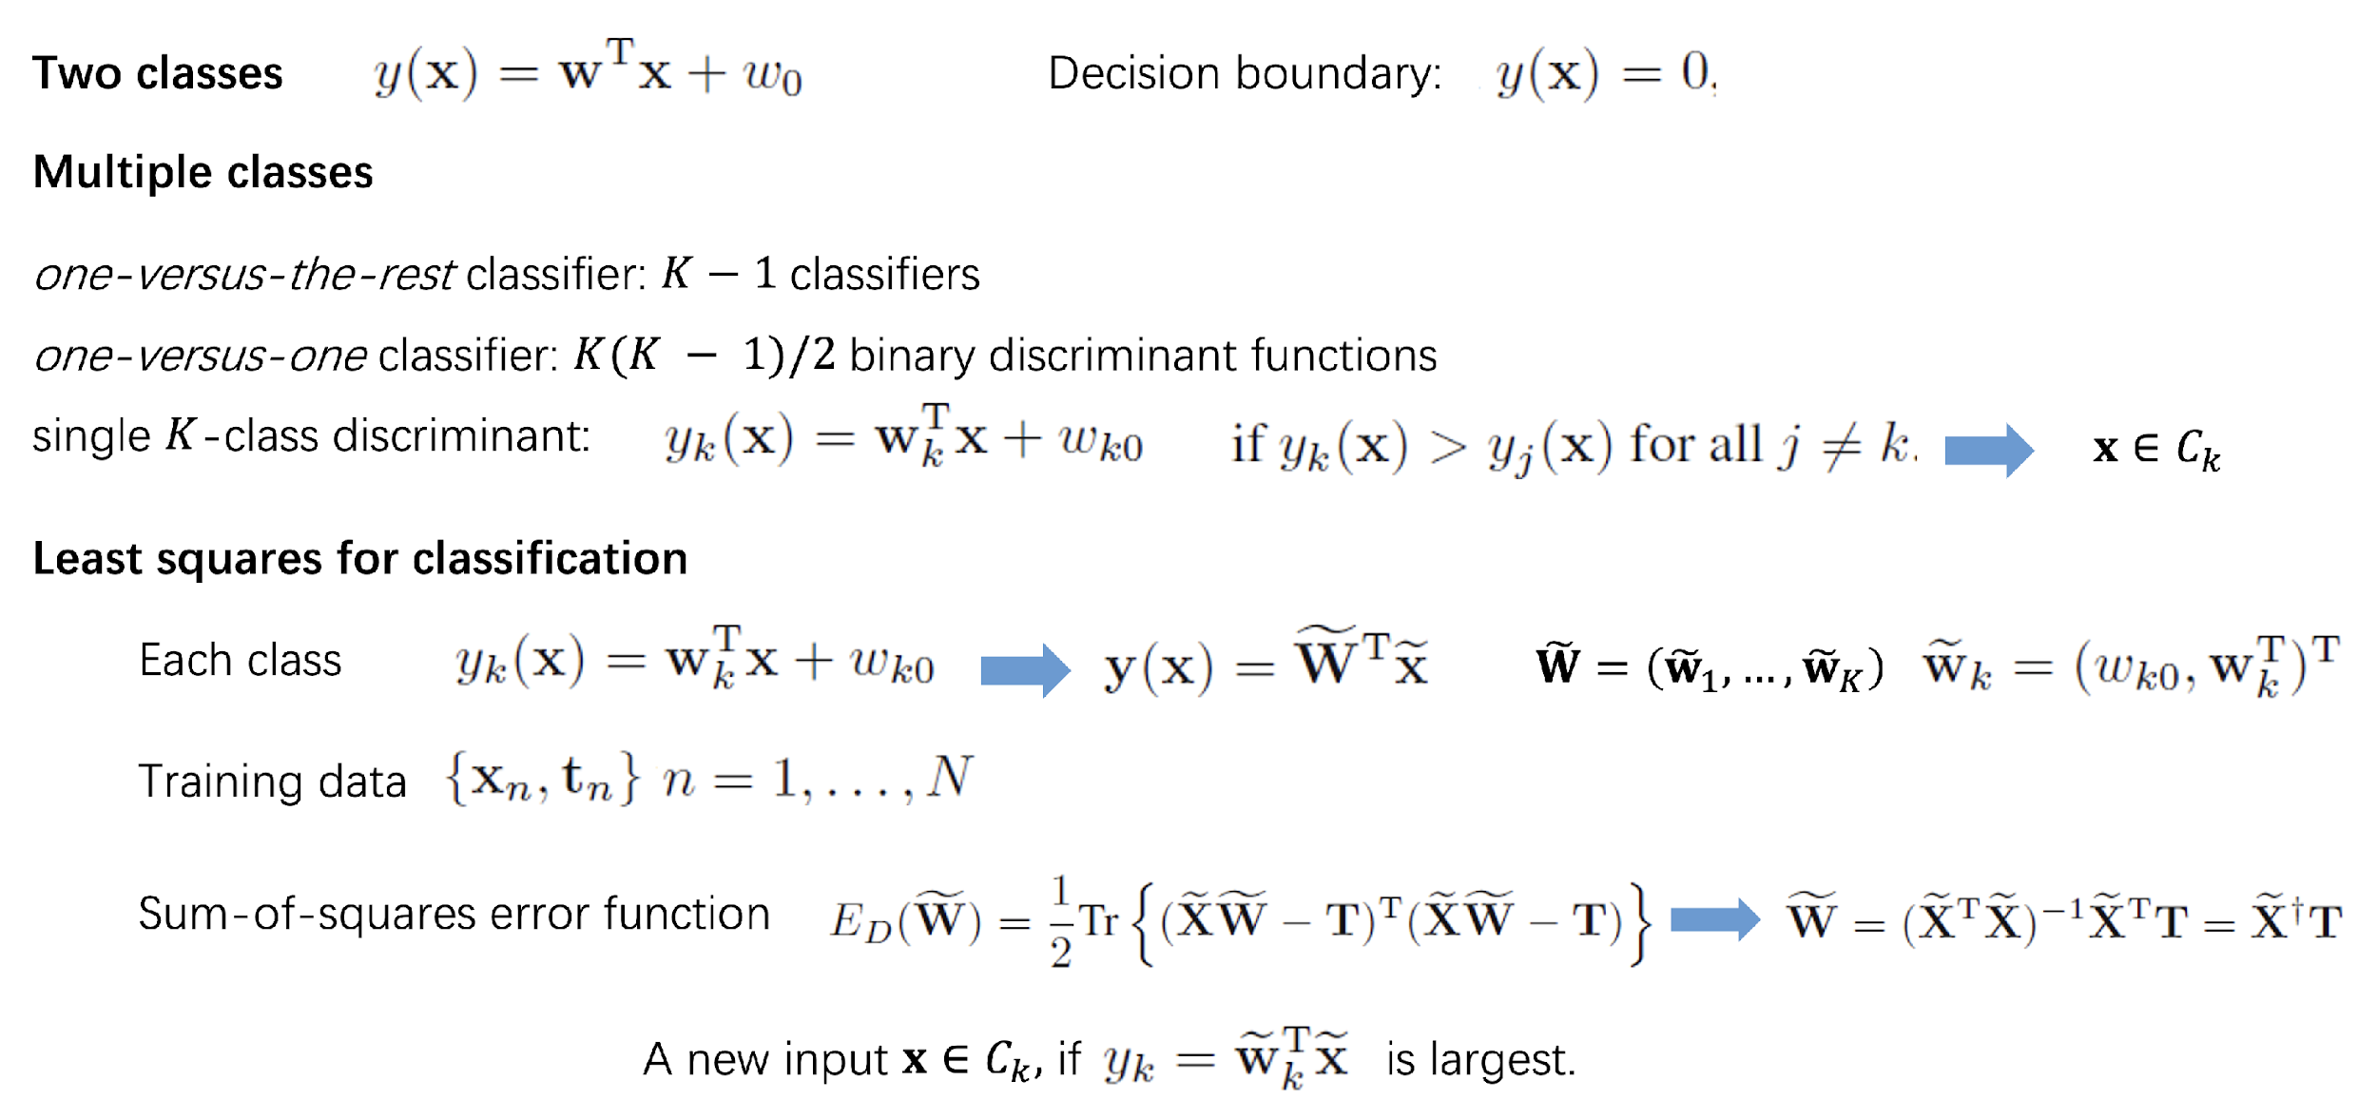
DISCRIMINANT FUNCTIONS

Slide 15
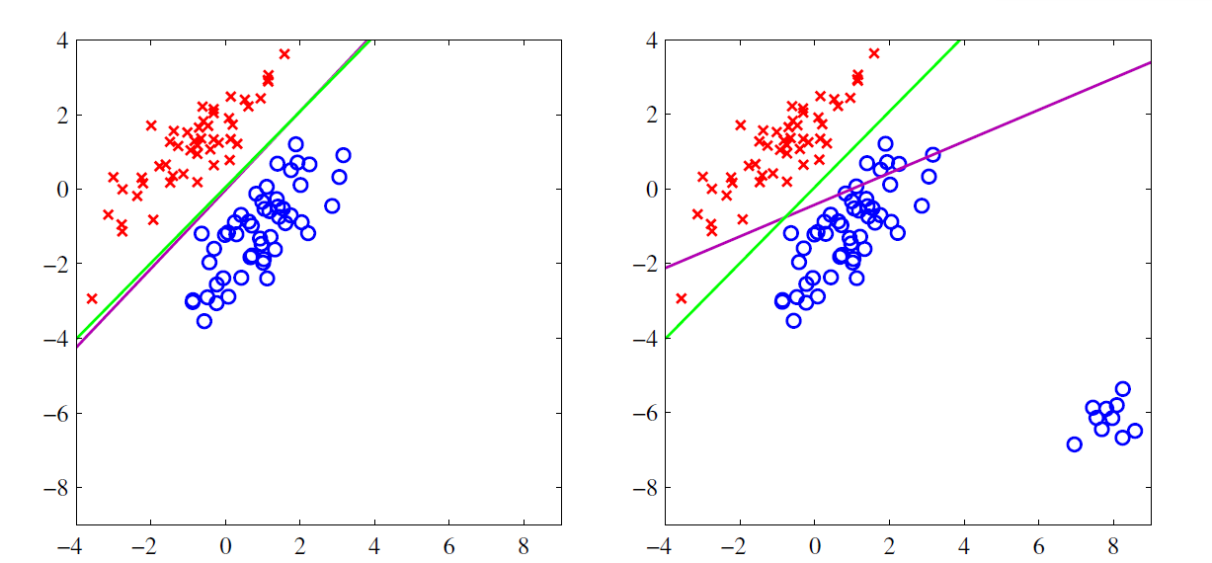
LEAST SQUARES FOR CLASSIFICATION

Slide 16
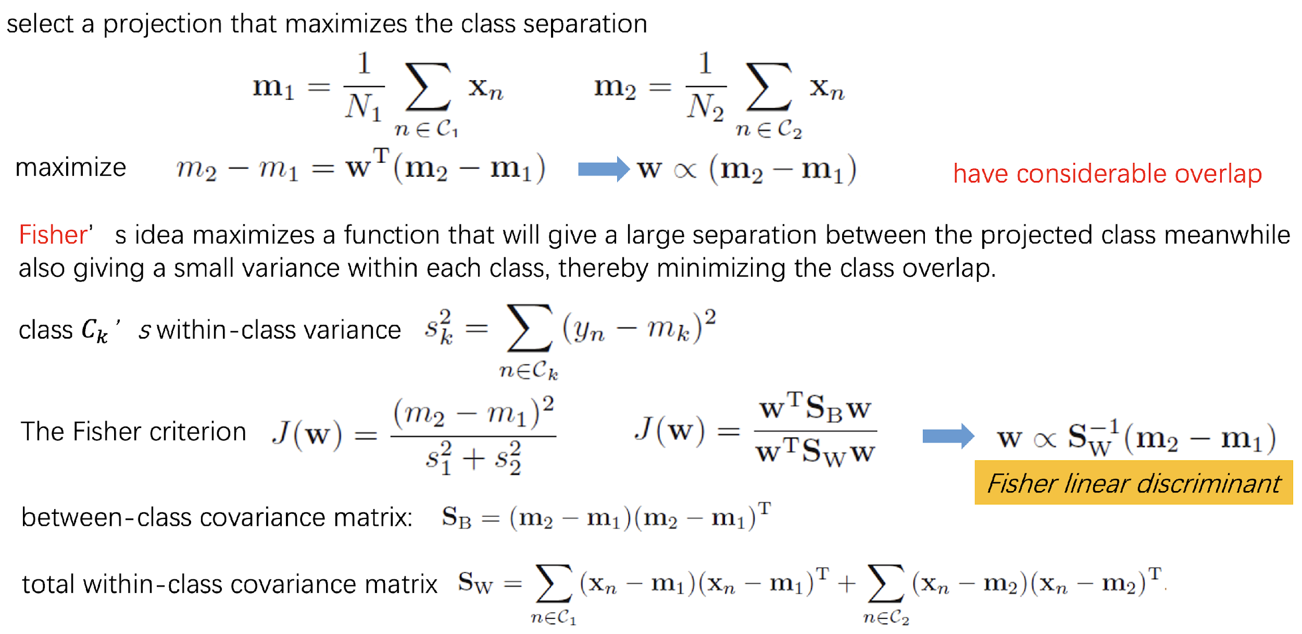
FISHER LINEAR DISCRIMINANT

Slide 17
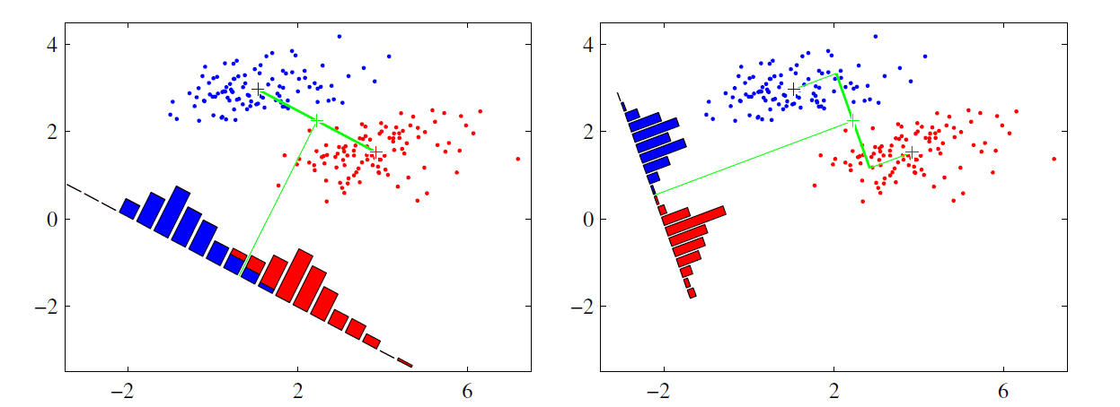
FISHER LINEAR DISCRIMINANT

Slide 18
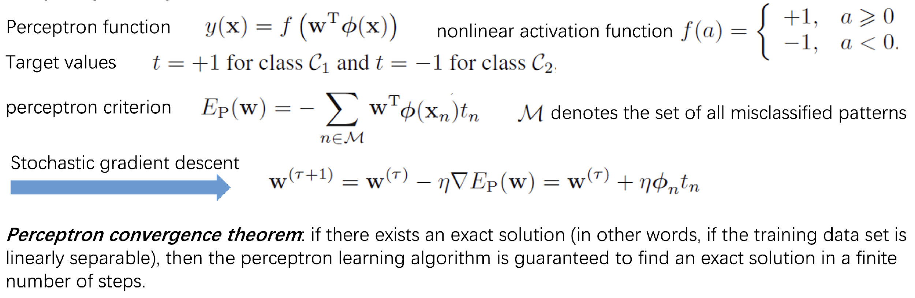
PERCEPTRON ALGORITHM
https://tamas.xyz/perceptron-demo/app/

Slide 19
OUTLINE
LINEAR MODEL FOR REGRESSION
LINEAR MODEL FOR CLASSIFICATION
LINEAR MODELS IN SCIKIT-LEARN
WEEK 2 HOMEWORK

Slide 20
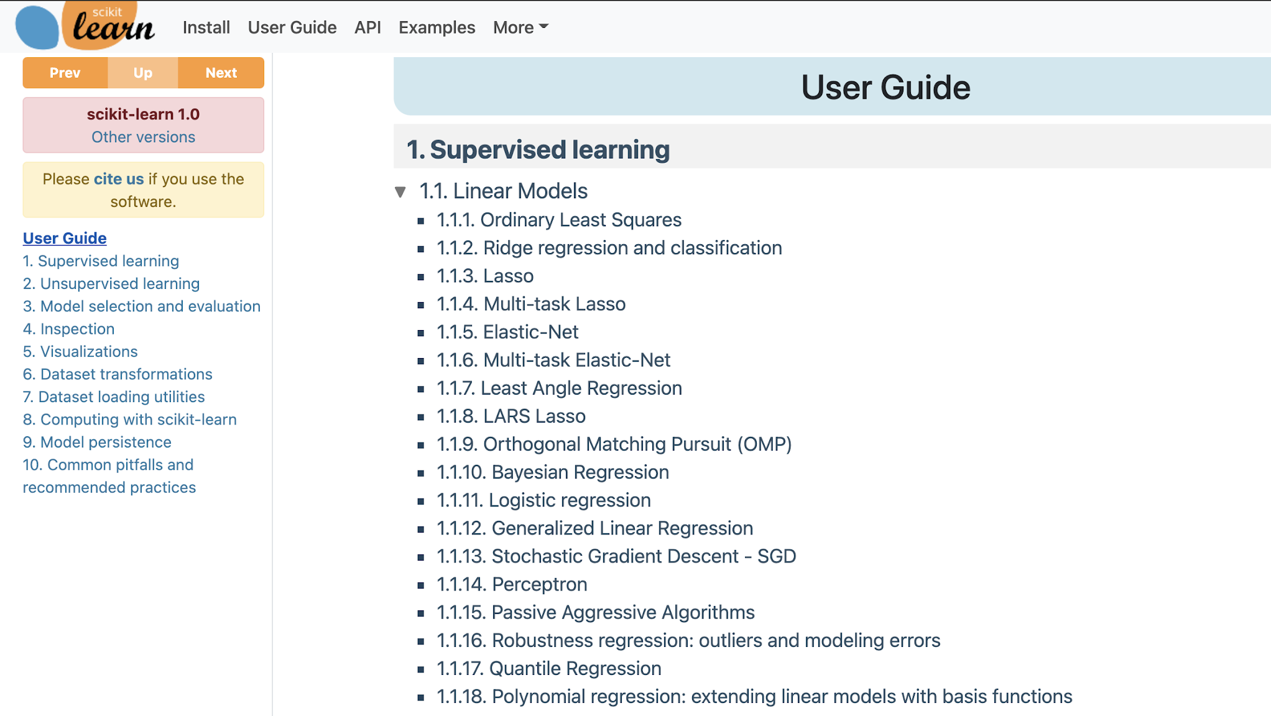
SKLEARN – LINEAR MODELS

Slide 21
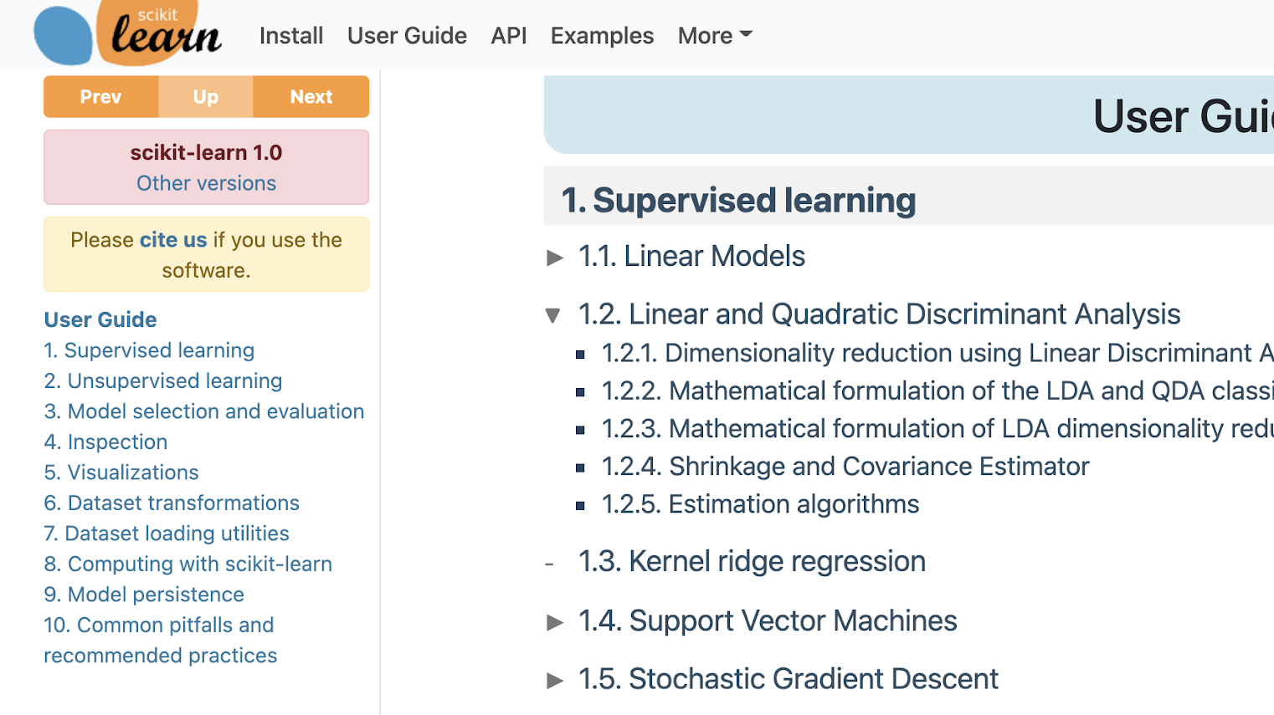
SKLEARN – DISCRIMINANT ANALYSYS

Slide 22
OUTLINE
LINEAR MODEL FOR REGRESSION
LINEAR MODEL FOR CLASSIFICATION
LINEAR MODELS IN SCIKIT-LEARN
WEEK 2 HOMEWORK

Slide 23
WEEK 2 HOME
WORK
Youtube Fun Videos!
StatQuest Linear Regression
Linear Discriminant Analysis (LDA)
Python Hack!
SKLearn Linear Models
Kaggle – Linear Regression
Notes:
https://www.kaggle.com/apapiu/regularized-linear-models

